Slide 1




Data integration and community engagement
EarthCube: Planet Microbe
Elisha M Wood-Charlson, PhD
University of Hawai‘i at Mānoa
@ElishaMariePhD @PlanetMicrobe

Slide 2
Data Discovery
Data Curation
Data Sharing
Cyberinfrastructure development to enable the geosciences
Improved tools for
analysis & visualization
Tracking data from
field to lab to publication
Notes:
EarthCube 2011(end-user workshops) Initiative NSF: Directorate For Geosciences (GEO) , Division of Advanced Cyberinfrastructure (ACI)
Goal - enable geoscientists to address the challenges of understanding and predicting a complex and evolving Earth system
2014: Community-­‐governed effort
Develop a common cyberinfrastructure to collect, access, analyze, share and visualize
All forms of data and resources, using advanced technological and computational capabilities.

Slide 3


EarthCube Projects
EarthCube Oceanography and Geobiology Env. ‘Omics (ECOGEO) RCN (2014-2017)
Planet Microbe – EarthCube building block (2017-2020)
Data (re)integration via iMicrobe

Slide 4
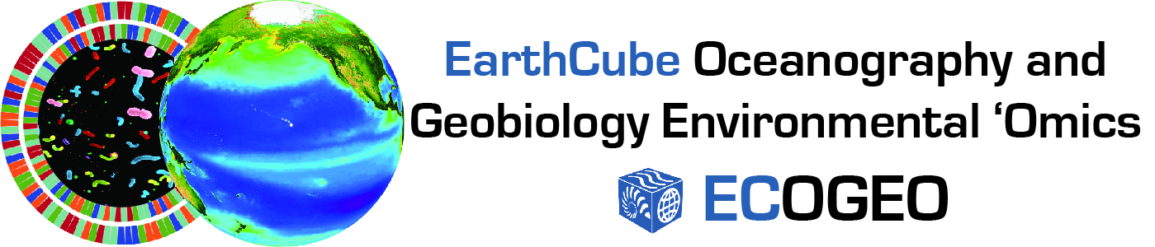
Resources
Workshop I: Grand challenges
Workshop II: Bioinformatics training
www.earthcube.org/group/ecogeo
Survey results, workshop reports
Training: slides, youtube videos, protocols.io

Slide 5
Main Use Case: Data Discovery
EarthCube Building Block:
Planet Microbe
Reuniting diverse data types by adaptively connecting data repositories to enable data discovery and open data sharing for oceanography and geobiology ‘omics.

Slide 6







Planet Microbe
HOT
BATS
NSF Sci Tech Centers
GeoLink, SeaView: R2R, IODP, LTER, OOI, OBIS, etc.
Governance: Science Committee
GeoDeepDive: “dark data” discovery (text, data mining)

Slide 7
PHASE ONE
CTD
BOTTLE
N₂O
CH₄
NUTRIENTS
PIGMENTS
MICROBIAL ABUNDANCE
SEQUENCE RELATED DATA
MICROBIAL ABUNDANCE
CARBONATE PARAMETERS
NUTRIENTS
BOTTLE
CTD
Notes:
Chemistry: british oceanography data center, supported by NERC (natural environment research council) – Evan (NCBI / NIST chem standards)
ChEBI – Chemical Entities of Biological Interest
Bermuda Atlantic Time-series Study - BATS: 1988 (Hydrostation S – 1955) Nick Bates, Rod Johnson, Mike Lomas
Several other projects within the BATS:
Carbon cycling
Production
Particle flux
Community structure – genetic, phylogenetic diversity, abundance
Microbial assimilation
Carbonate system dynamics
Hawaii Ocean Time-series - HOT: 1988
Transport studies
Microbial ecological studies
Microbial loop

Slide 8
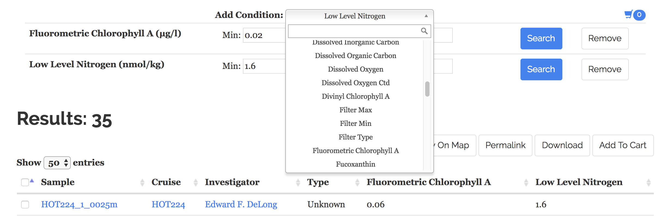
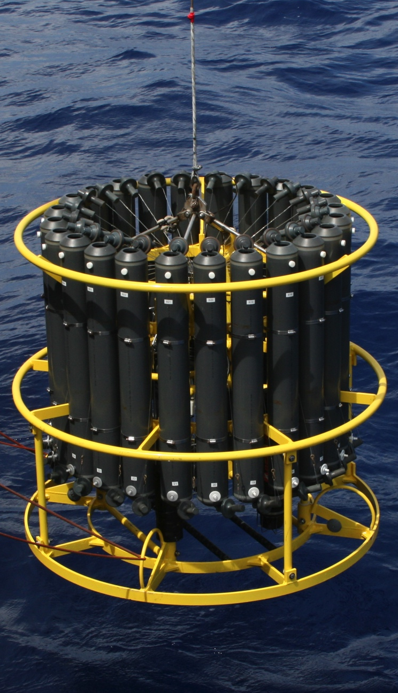
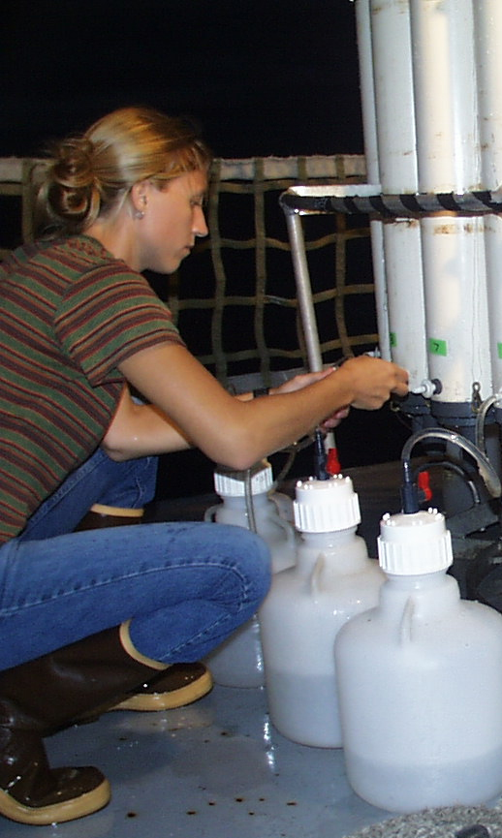
Planet Microbe
CTD + ROSETTE
Core variables: Lat, Lon, Time, Depth
Data types:
Continuous – CTD sensor data
Discrete – nutrients, sequence data, etc.
Notes:
Contextual metadata search
Will expand to distant algorithm w/ confidence interval around inferred contextual data (currents, ocean models, etc)

Slide 9

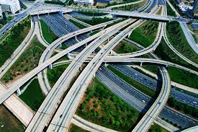
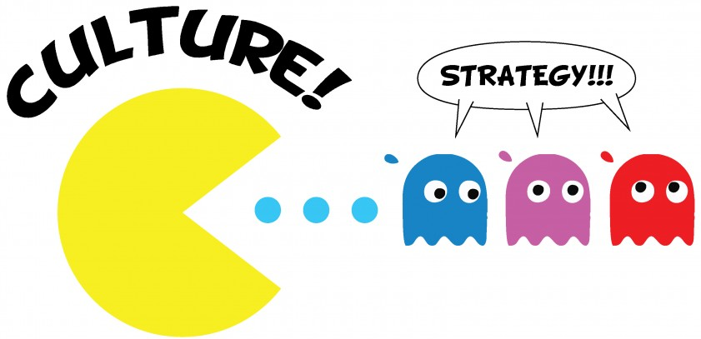
Challenges
Data
Easy to get, hard to make FAIR
Infrastructure
Hard to build, easy to make difficult
Culture
Hard to manage, harder to change
Integrating all three…
“Culture is what happens when you are not there.” – Rex Miller
Notes:
“Culture is what happens when you are not there.” – Rex Miller
http://gomindshift.com/general/your-shadow-culture-eats-strategy-for-breakfast/

Slide 10
Challenges for data integration
Core variables
Context
Ontology
Data sharing, open science
Notes:
Your Standards/QC – more important to have prior to data integration, domain specific challenges
File types and data streams – discrete, continuous
Context - metadata

Slide 11
Challenges for cultural integration
Core variables
Context
Ontology
Data sharing, open science
Core values
Context
Shared vocabulary
Trust, transparency
At the end of the day, it is not really about data…
It is about COMMUNITY
Notes:
Putting the ship back on course…
Standards/QC – more important to have prior to data integration, domain specific challenges
Context for interactions

Slide 12


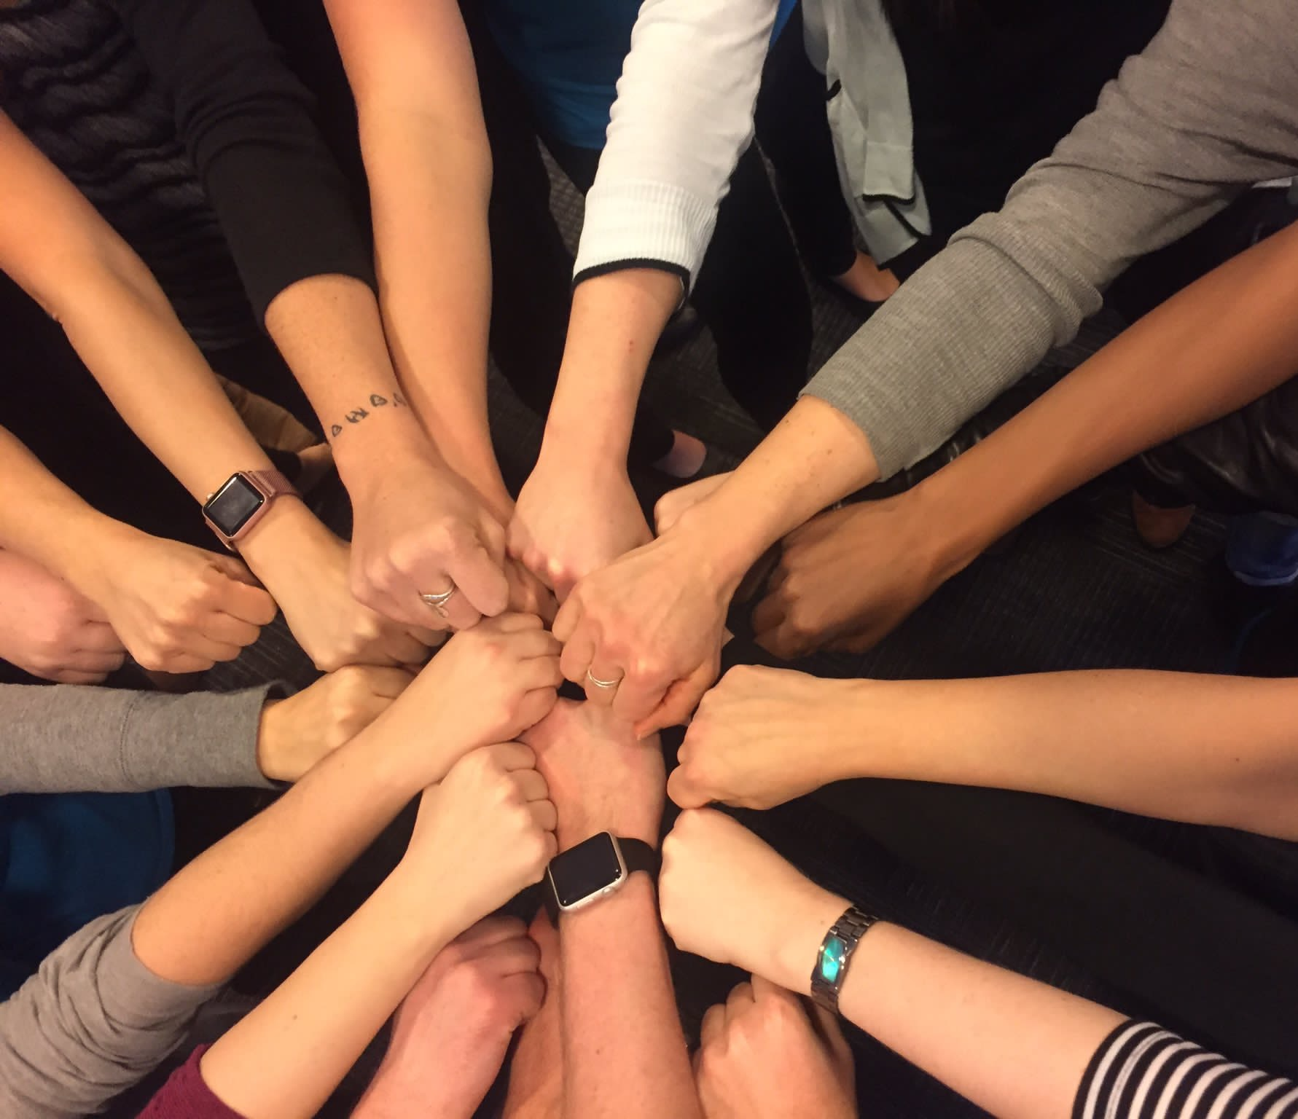

Community Engagement (in an online data platform world)

Slide 13
Science community engagement (my $0.02)
Goals
Enable communication & collaboration
Enhance knowledge transfer & discovery
Develop shared ownership, trust
Normalize desired behaviors
Notes:
Goals for building an engaged community
Open science, open data, data management best practices, standards, ontology, etc.
Code of conduct – transparency, ownership/authorship, etc.

Slide 14
Science community engagement
Notes:
A way to visualize these goals – nice thing about online platforms is these behavior changes can be quantified

Slide 15
Science community engagement
Communicate
(align)
Connect
(recruit)
Collaborate
(produce)
Co-create
(iterate)
stages of maturity – strategic process
Notes:
Onboard people, set up safe space for trust, transparency = communicate about alignments in research interests, collaborations – research products (pubs, talks, new models, data sets, etc), co-create – proposal with next hypotheses

Slide 16
Science community engagement
Best practices
Observe, listen, understand, support
Shared purpose - shared value - shared goals
Organizational goals
Shared
Stakeholder goals
Enhance knowledge transfer & discovery
Develop shared ownership, trust
Find answers to key research questions
Publish, get funding
Communication
Collaboration
Notes:
User working group! Use cases, feedback, iterative development, delivery
Prev slide w/ goals = organizational objectives

Slide 17

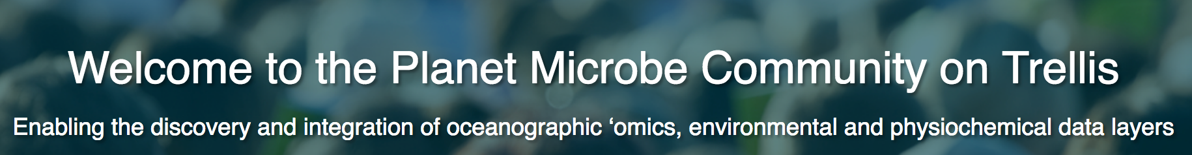

PM: Community engagement
http://www.trelliscience.com/planetmicrobe/
Notes:
My role – run online platforms for convo and feedback, townhalls at conferences – then translate to CI developers for implementation
Talk story – translating the concept of Cruise, Station, Cast, Bottle

Slide 18

PM: Community engagement
Community-driven standards
Sean Jungbluth (JGI)
Key variables: Temp, redox balance, pH, organic C (TOC, DOC), nutrients
-> Creation of community-driven standardized protocols?

Slide 19
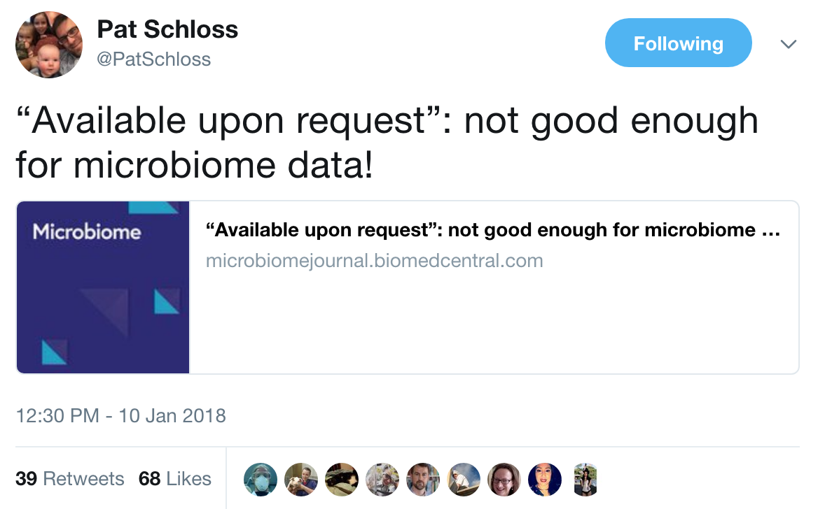
PM: Community engagement
Community-identified challenges

Slide 20
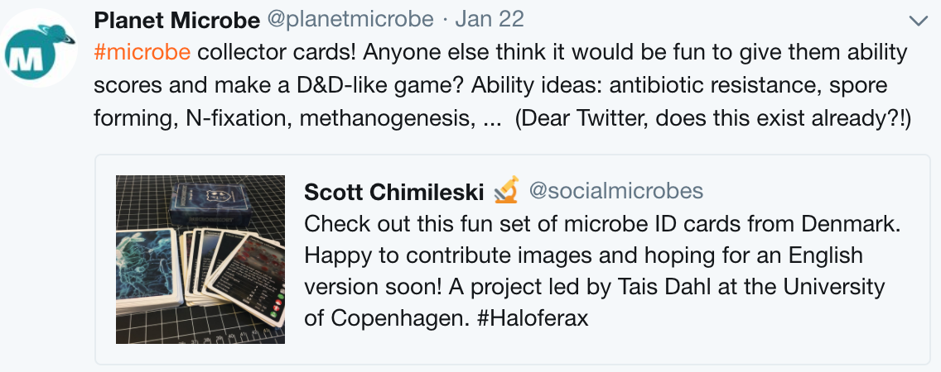
PM: Community engagement
Community-driven fun

Slide 21


Mahalo – Qs?
www.trelliscience.com/NMDC/
www.trelliscience.com/planetmicrobe

